Slide 1
Advanced AJAX
Lesson 6.2

Slide 2
Learning Objectives
01
Solidify understanding of APIs, JSONs, and their roles in full-stack web development
02
Increase comfort working with APIs and AJAX calls in data-rich applications

Slide 3
API Recap

Slide 4
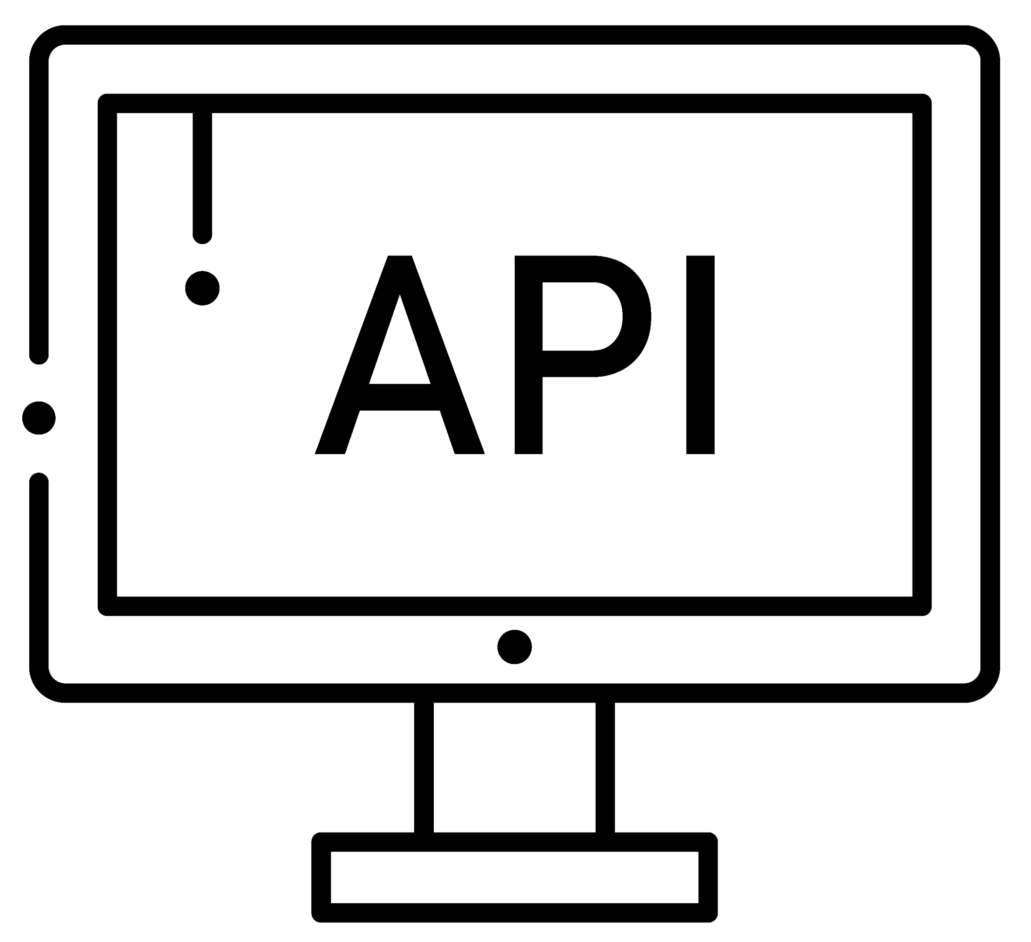
What Is an API?

Slide 5

An application programming interface (API) is a set of features and rules that exist inside a software program (the application) enabling interaction with it through software—as opposed to a human user interface.
— MDN Web Docs, developer.mozilla.org
AJAX and APIs

Slide 6

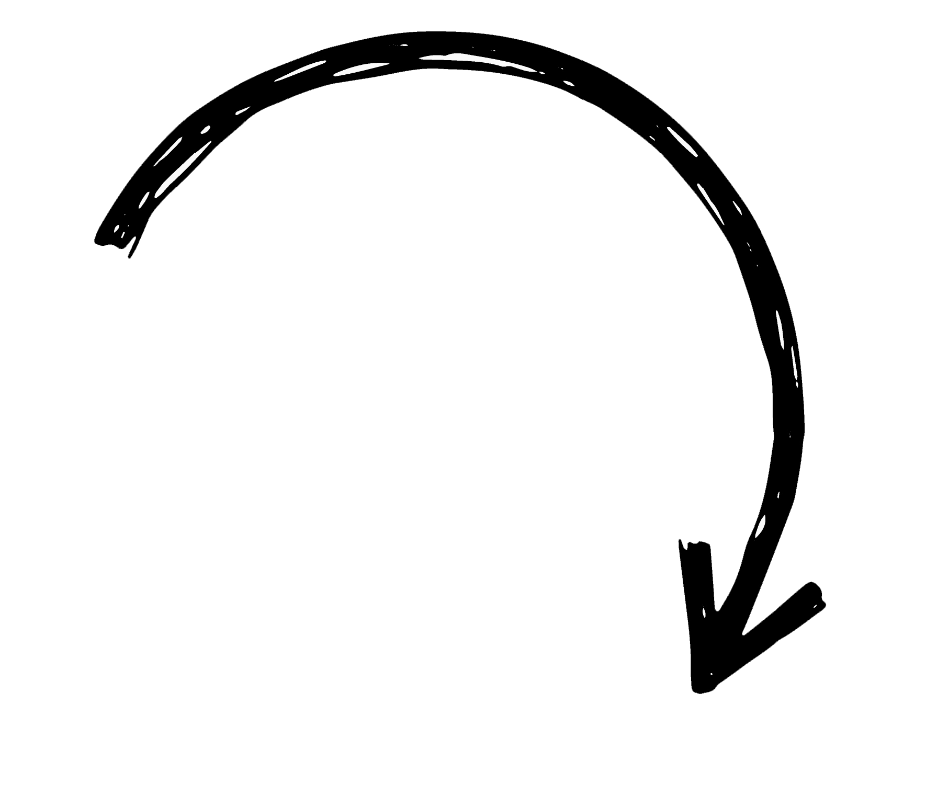
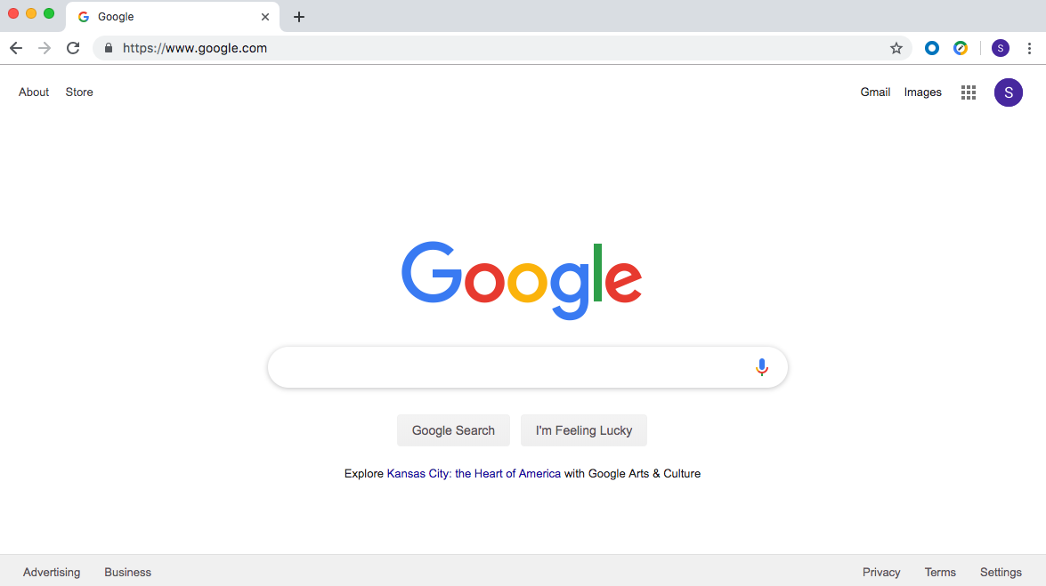
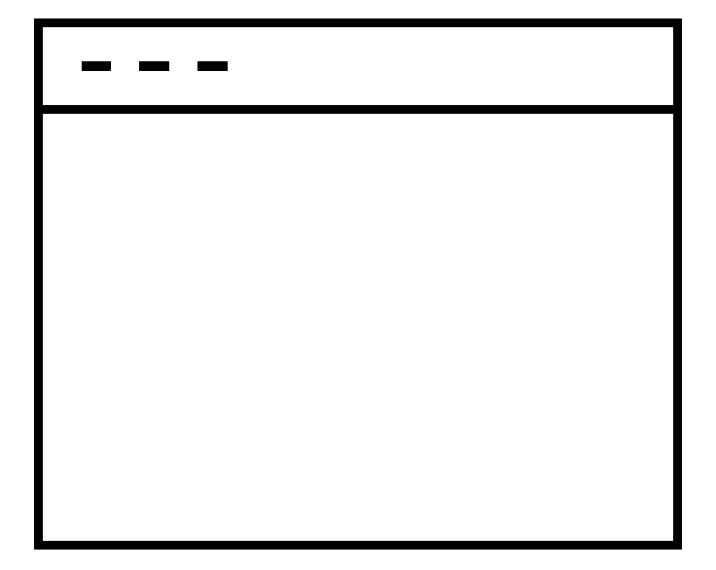
API Recap
In software development, APIs are often the bridge between different components.
3rd Party APIs
Your Browser
Browser APIs
Core JavaScript Language
Notes:
Screenshot is considered low-risk in regards to copyright.

Slide 7
API Use Cases

Slide 8
Three Common Use Cases for APIs
01
Provide pre-built code for accessing and sending data to a centralized database (e.g., weather data, movie data from OMDB).
02
Provide pre-built code for creating or utilizing other software components (e.g., Google Maps, Spotify tools).
03
Interface with physical sensors or hardware devices (e.g., Nest thermostats, Philips Hue).

Slide 9
Use Case #1: Accessing and Sending Data

Slide 10

Example:
Airbnb utilizes the Google Maps API to power its entire mapping service.
Notes:
shutterstock_461093119

Slide 11
Use Case #2: Utilizing Pre-Built Code

Slide 12
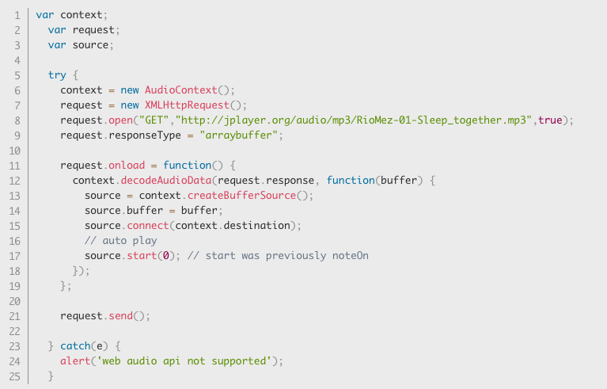
Use Case #2: Utilizing Pre-Built Code
developer.mozilla.org

Slide 13
Use Case #3: Controlling Physical Hardware
Nest Smart Thermostat API: developer.nest.com
Philips Hue API: developers.meethue.com
NodeBots (Cylon.js) API: cylonjs.com

Slide 14
JSON Recap

Slide 15

What Is JSON?

Slide 16
JSON stands for JavaScript Object Notation and is nothing more than simple JavaScript objects used as a data interchange format.

Slide 17
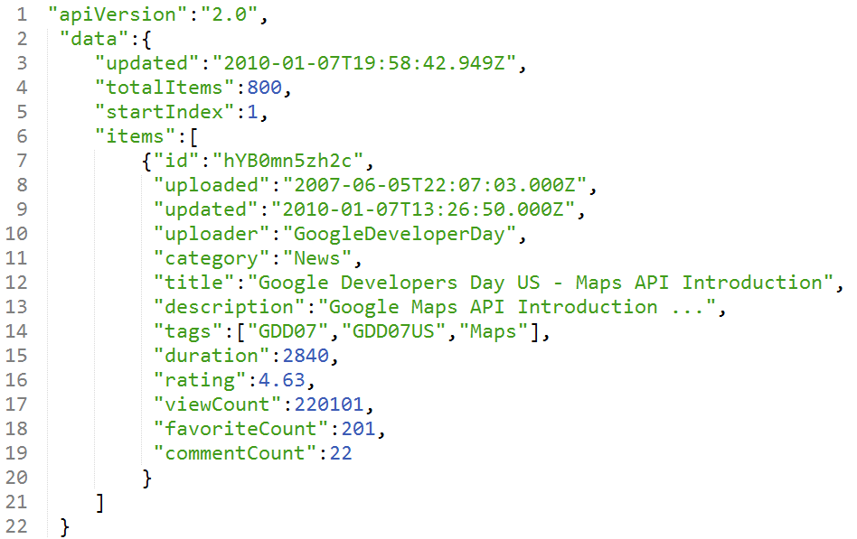
JSON Recap
JSON is a lightweight data interchange format used to correlate keys with values.

Slide 18
Getting Data

Slide 19

What jQuery method do we use to retrieve data via a URL?

Slide 20


Slide 21
What two parameters do we pass into AJAX to retrieve data from online?

Slide 22
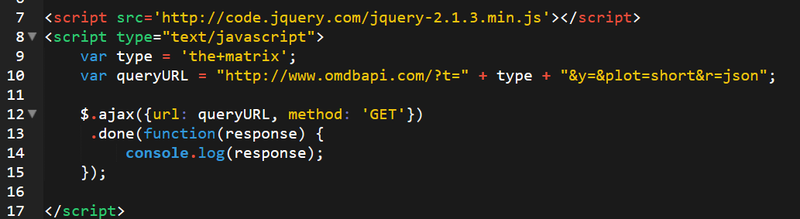
AJAX
What two parameters do we pass into AJAX to retrieve data from online?
url ‘GET’ method

Slide 23
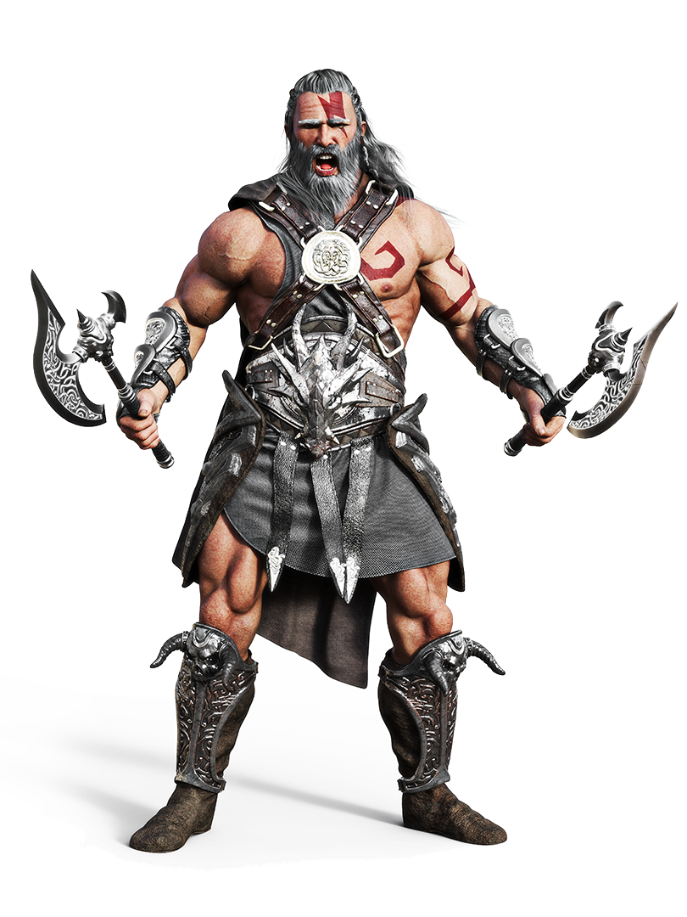
Knowledge Is Power
Notes:
shutterstock_1037716798

Slide 24


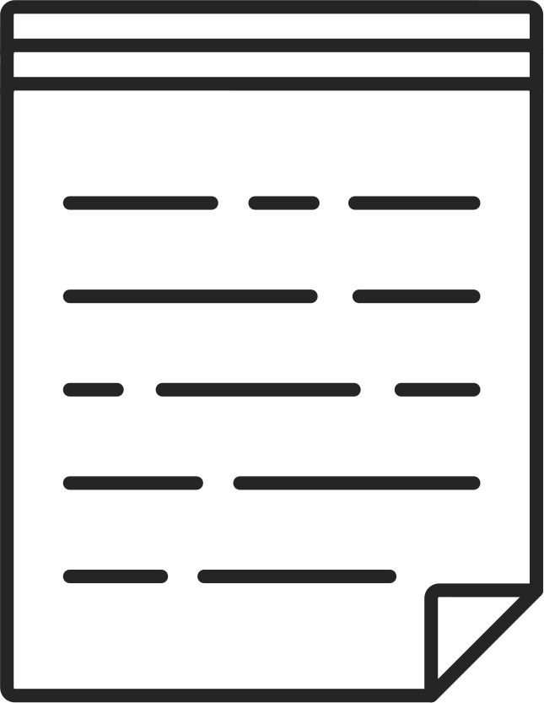
Welcome to Full-Stack Development
Full-stack development refers to the development of every aspect of the web application, from visuals and interactions to data transfer and processing.
Client Browser (Front-End)
React.js
HTML/CSS/Image Assets
JavaScript (Client Side)
JSON/XML
User Interactions
Server (Back-End)
Node.js
Express Web Server
Server-Side Scripts and Services | Raw Files
MongoDB
Database
USER
Request
Response
AJAX and APIs

Slide 25
AJAX and API Overview
At this point, you should know:
The definition of API
The definition of JSON
Why AJAX methods are used (i.e., retrieving data in databases).
How to create a basic AJAX get request using jQuery (i.e., include URL and ‘GET’).

Slide 26
Questions?

